Slide 1





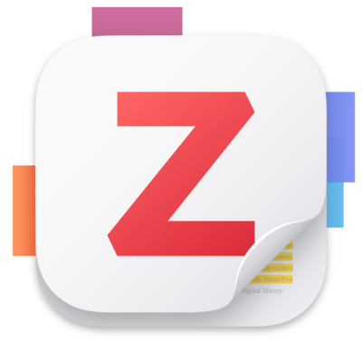
Tools and strategies for efficient and effective Literature Reviews
Gabriel I Vega Bellido
03/24/2025

Slide 2
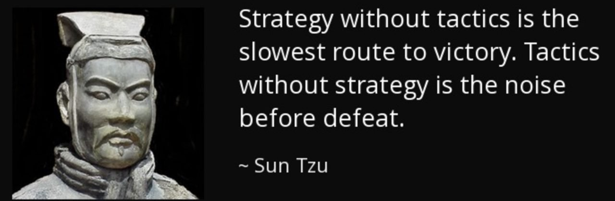
Why should you use tools and strategy in your literature review?
The number of scientific publications has risen exponentially over time, it is easy to be overwhelmed by the amount of literature out there.
A literature review is a complicated process with multiple parts:
Find papers or sources relevant to your topic
Organize and manage sources and citations
Extract insights from multiple sources
Store, organize, and synthesize these insights
The right tools and strategy can help us more efficiently and effectively conduct our literature review.

Slide 3

Before you start: Establish a search strategy
A solid search strategy will help you avoid missing important work, keep you focused, and avoid irrelevant results.
Ways to tailor your strategy:
Define your question clearly: What am I studying? What do I want to know?
Identify core concepts and keywords
Use select sources: Specific databases or journals
Have inclusion/exclusion criteria: Last 10 years, focused on specific topic, not a conference abstract
Use citation chaining and email alerts

Slide 4

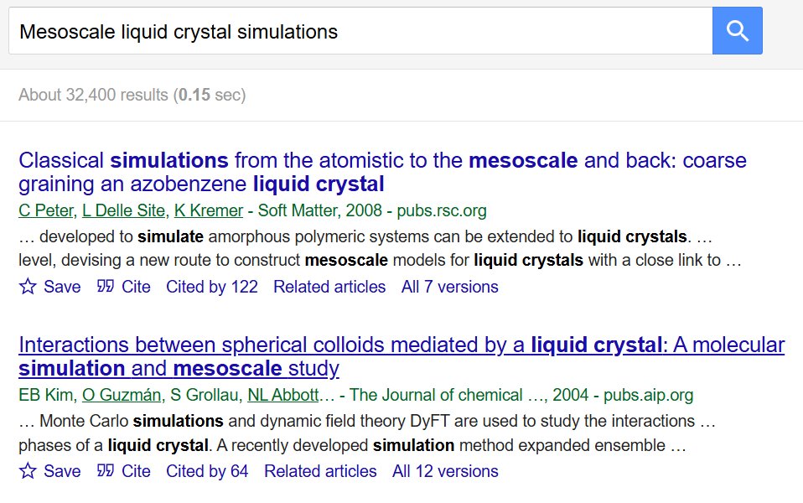
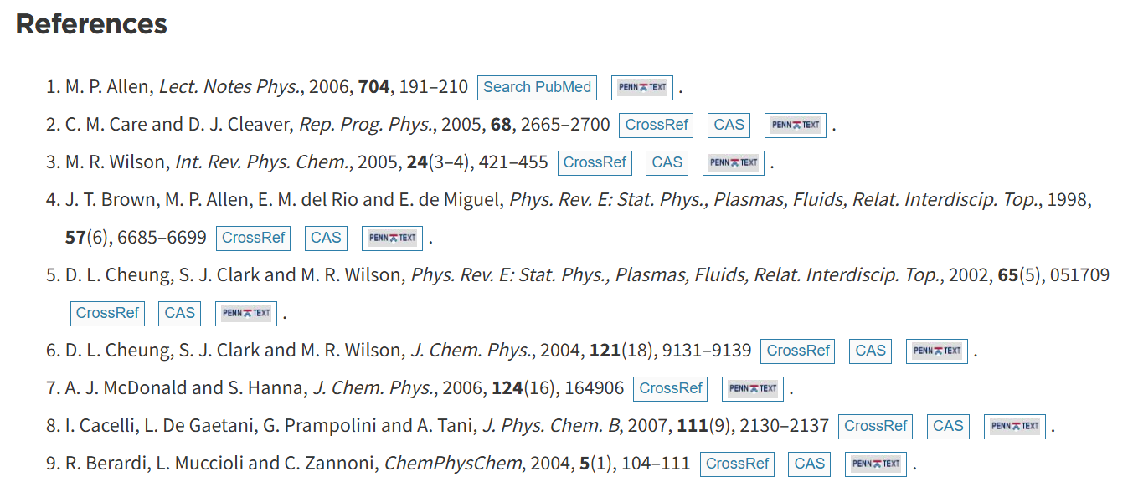
Finding sources: Keyword search with Google Scholar
Google Scholar is a search engine specifically designed for finding scholarly literature from diverse sources.
Process overview:
Use keywords to search for a foundational paper on the topic
Examine the reference list of the paper to find additional relevant studies
Repeat the process with newly found papers to expand search

Slide 5
Finding sources: Keyword search with Google Scholar
Pros:
Direct engagement with foundational works
Intuitive process, minimal learning curve
Cons:
Time consuming manual search process
Limited by scope and biases of selected papers, could overlook pertinent studies not cited in the initial works

Slide 6
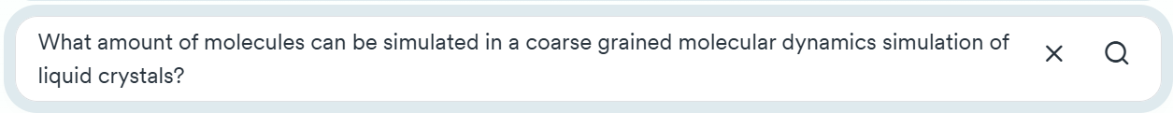
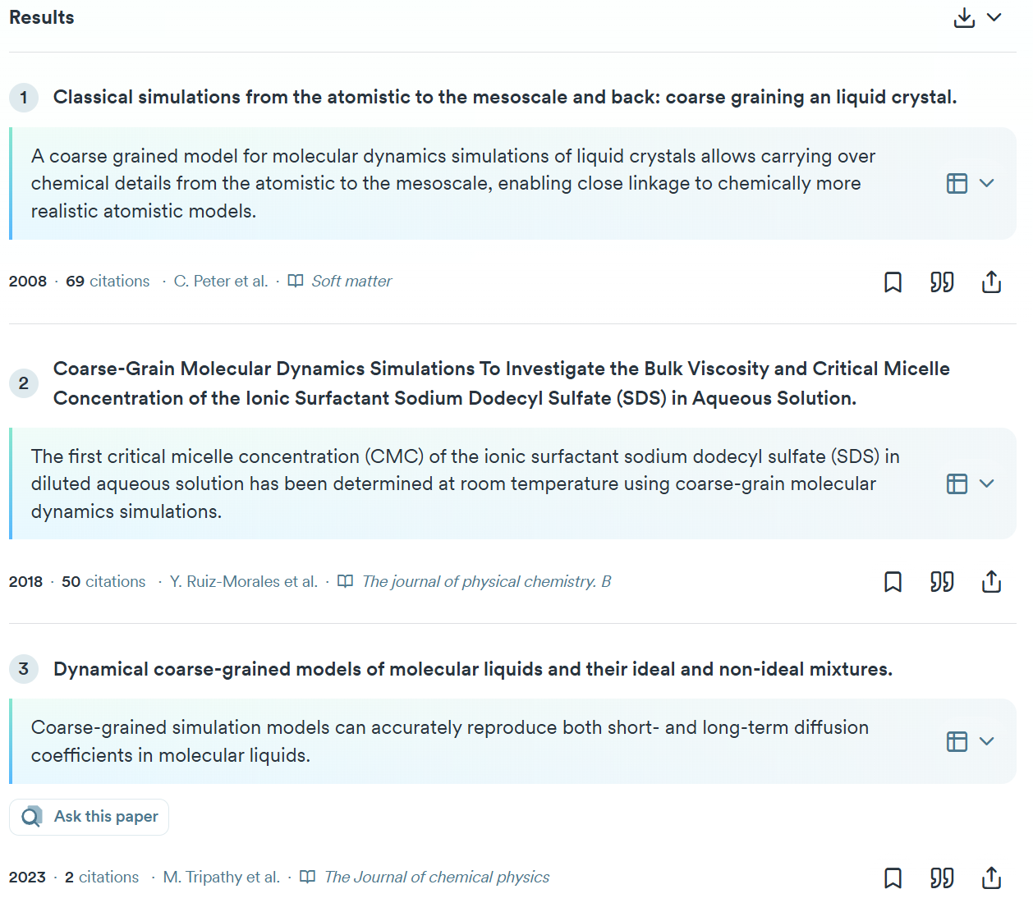
Finding sources: Semantic Search with Consensus AI
Consensus AI is an academic semantic search engine that sifts through Semantic Scholar’s database of research papers to provide you with relevant findings.
Process overview:
Use a natural language query to find precise academic results
The platform will search over 200 million papers from the Semantic Scholar database
Get concise summaries with the key takeaways from relevant papers
Choose a paper to dive into based on summary relevance

Slide 7
Finding sources: Semantic Search with Consensus AI
Pros:
Can use natural language to home in on your question of interest
Responses are grounded in scientific research, ensuring reliability and credibility
Simple user interface and concise summaries
Cons:
Results dependent on quality of query
Basic functionality is free but advanced features require a premium account
Replicable with popular LLMs

Slide 8
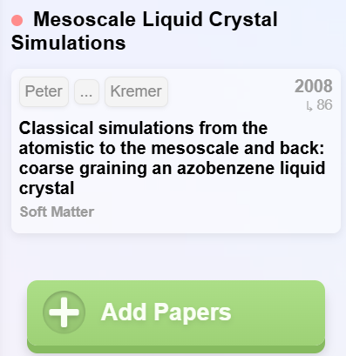
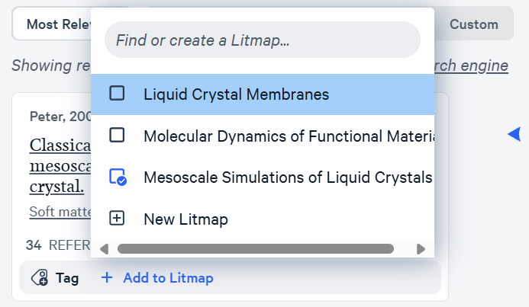
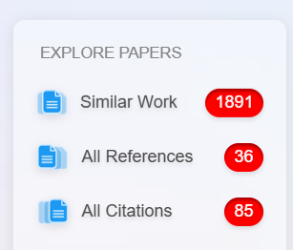
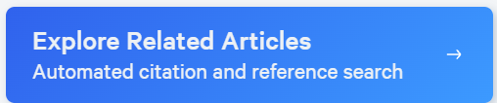
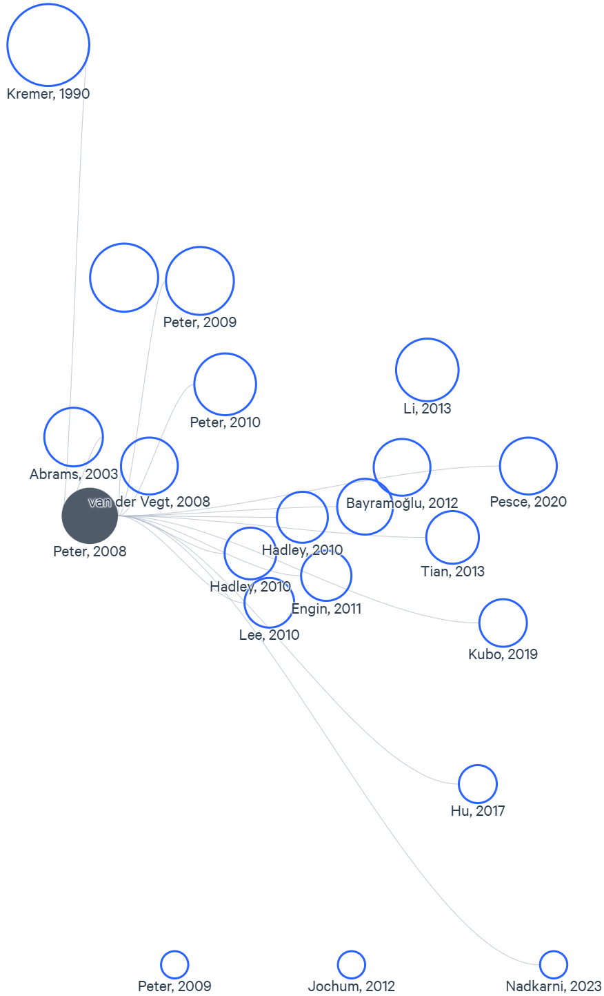
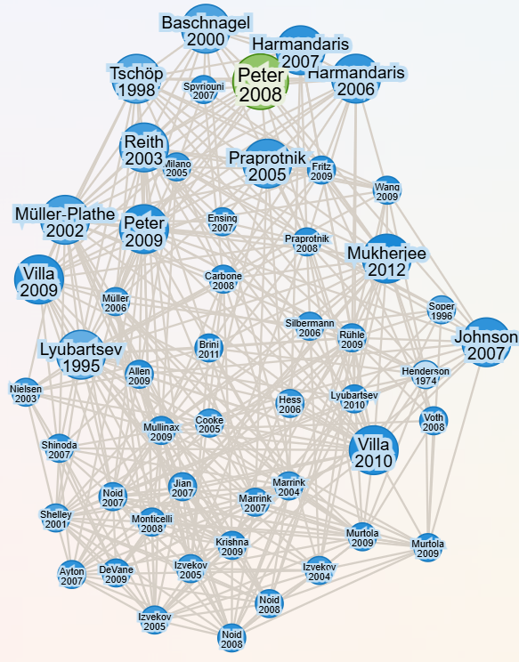
Finding Sources: AI-Generated Literature Maps with ResearchRabbit or Litmaps
These are tools that generate citation maps to help researchers explore scholarly literature by visualizing connections between publications.
Process overview:
Select one (or multiple) pertinent “seed” paper(s) related to your research focus
Input the paper into ResearchRabbit or Litmaps
Generate an interactive citation map that recommends related studies
Choose more papers to add to your literature map to iteratively improve it

Slide 9
Finding Sources: AI-Generated Literature Maps with ResearchRabbit and Litmaps
Pros:
Fast identification of most relevant papers
Visually displaying connections between studies helps to spot patterns and gaps
Continuous improvement of search through iterative selection of seed papers
ResearchRabbit is free
Cons:
Dependent on quality of database and algorithm used to create map
Slight learning curve
LitMaps requires a subscription to remove cap on inputs and generated maps

Slide 10
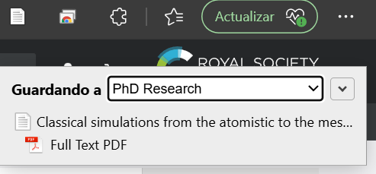
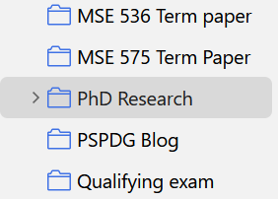
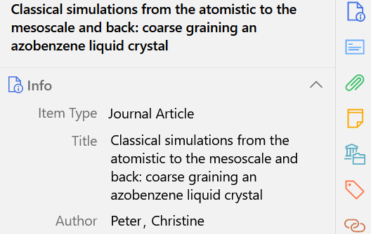
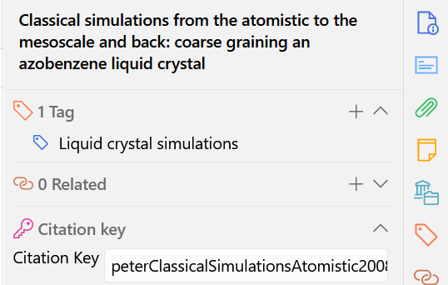
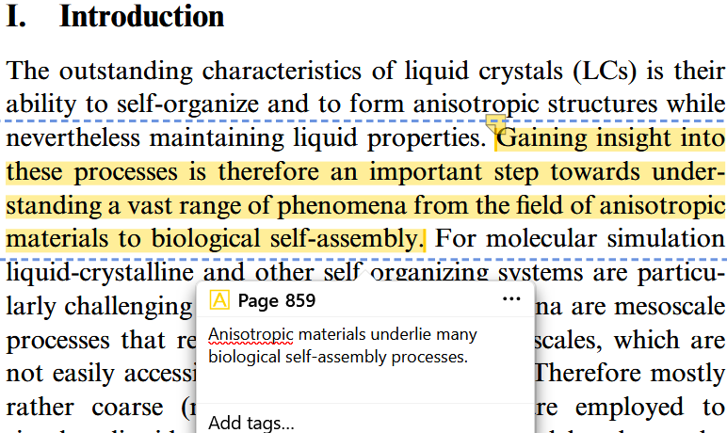
Reference and source management: Zotero
Zotero is a free and versatile reference management tool:
Compatible with various browsers to automatically extract citations from web pages
Can organize references with collections and tags
Offers PDF annotation and note-taking
Good integration with various other tools
Quickly generate a bibliography with proper formatting
Highly recommend using!

Slide 11

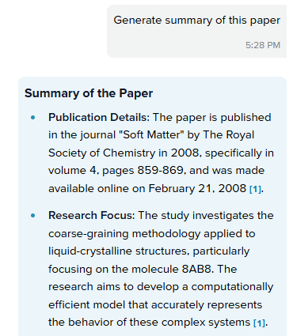
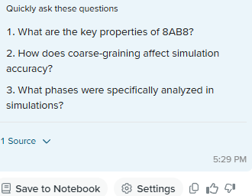
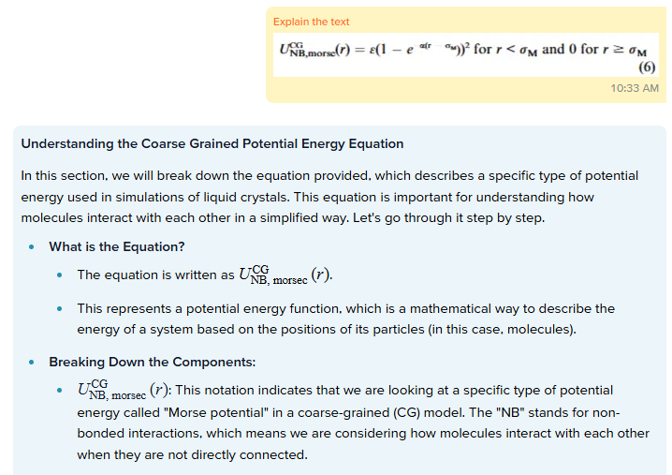
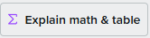
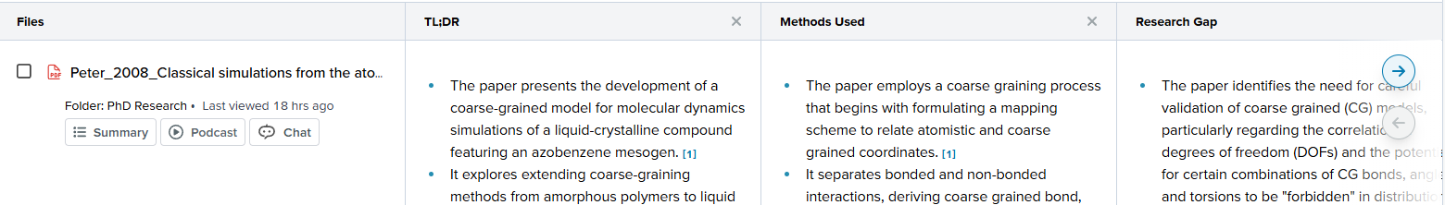
Extracting insights: SciSpace
“All-in-one AI tools for students and researchers”
Offers comprehensive summaries for an overview of the paper
Allows one to “Chat with PDF”, allowing you to ask specific questions about a document and receive contextual answers
Can explain equations, tables, and figures
Can extract pertinent data from multiple uploaded PDFs simultaneously and organizes it into tables for efficient analysis

Slide 12
Extracting insights: SciSpace
Pros:
Allows you to interactively understand a paper
Can break down figures, equations, and tables
Compare findings from many papers simultaneously
Cons:
Somewhat bloated functionality
Not great for in-depth technical understanding
Premium account required for unlimited uses

Slide 13
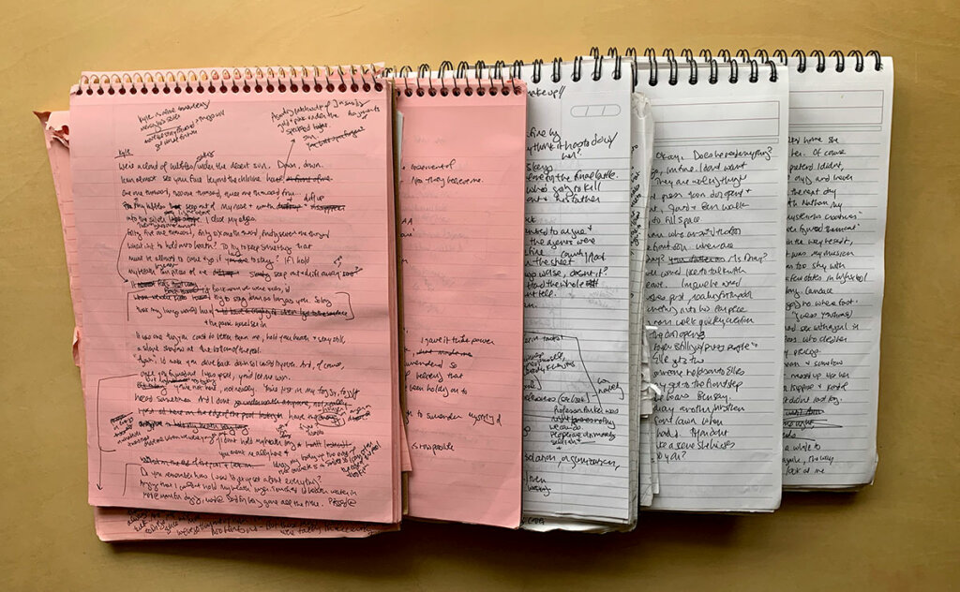
Storing, organizing, and synthesizing insights: Note taking
Note taking is how we store information
Doing so in a disorganized way makes retrieval and processing of information difficult in the long term
Proper organization can greatly improve this, facilitating creative synthesis of new ideas

Slide 14
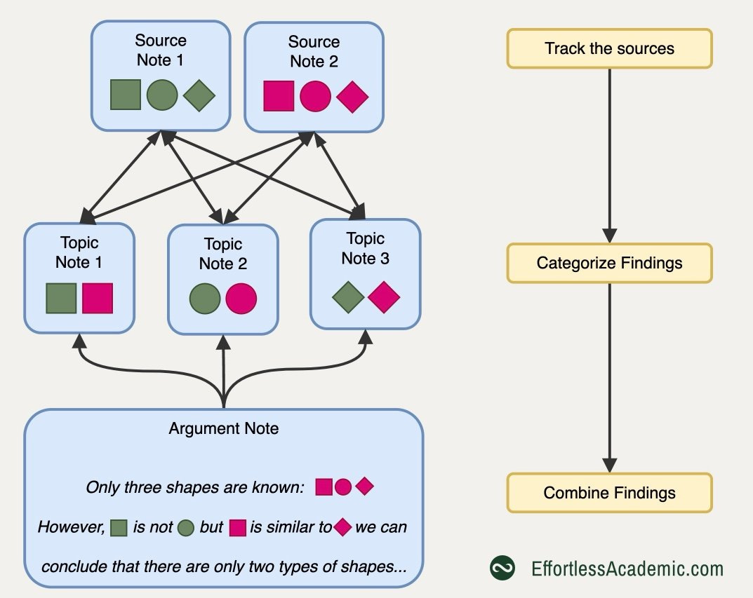
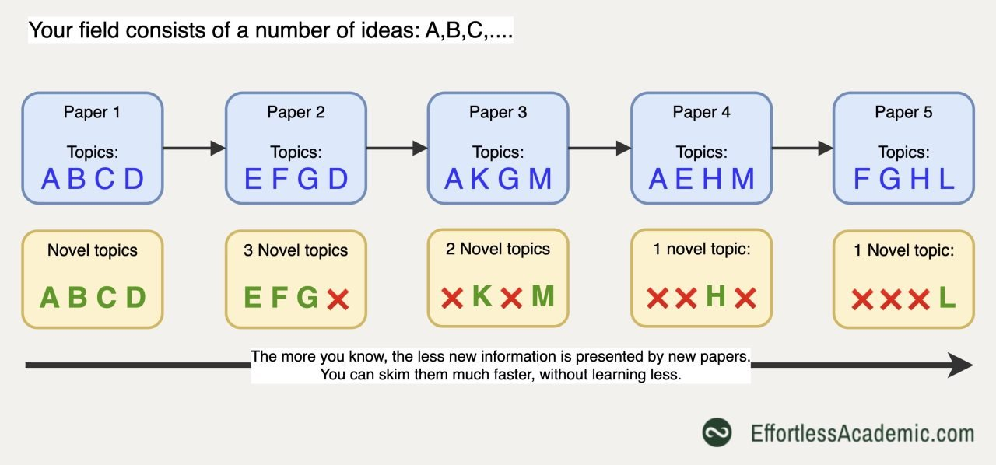
Note Taking Strategy: Source-Topic-Argument (Capture, Connect, Crystallize)
Any field of study consists of a limited number of ideas or concepts
As you become familiar with a field, each additional paper/book you read adds less to your overall understanding
Avoid redundant notes by structuring information into:
Source notes: Notes on a single paper or book (metadata, summary, keypoints) which track the origin of information
Topic notes: Aggregate insights from multiple sources on the same topic, link back to sources
Argument notes: Synthesize topics using your own words and develop your ideas

Slide 15
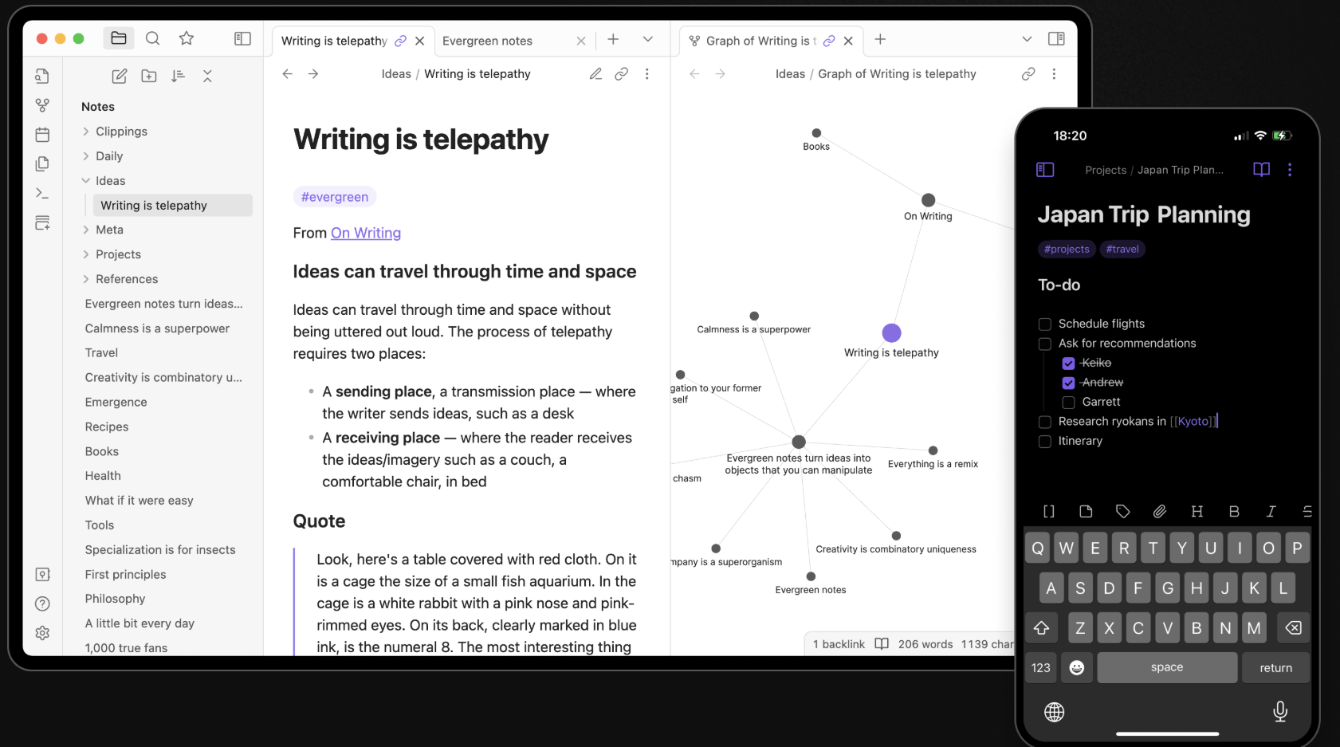
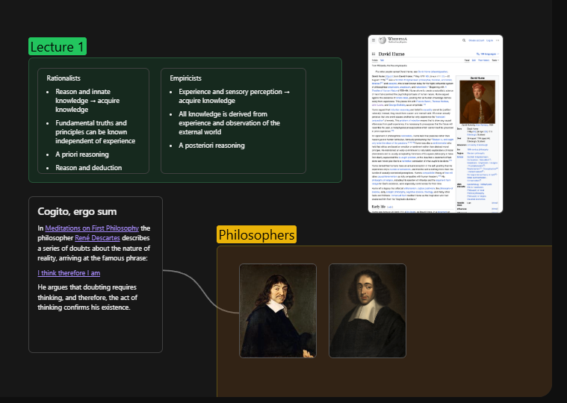
Note Taking Tactics: Obsidian
Obsidian is a free Markdown note-taking app with a long list of features, but we are mostly interested in:
Easy organization using folders and tags
Allows linking of notes, visualizes connections in Graph View
Host files locally which can be synced across devices
Can make templates for notes of a similar type
Canvas lets you get creative with visualization
A lot of community plugins for additional functionality and customization, including Zotero Integration

Slide 16

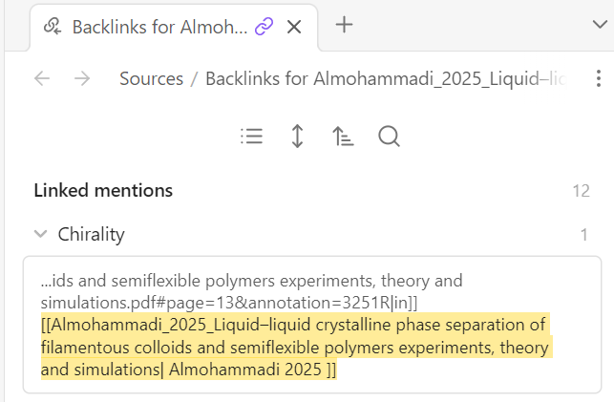

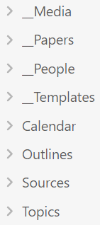
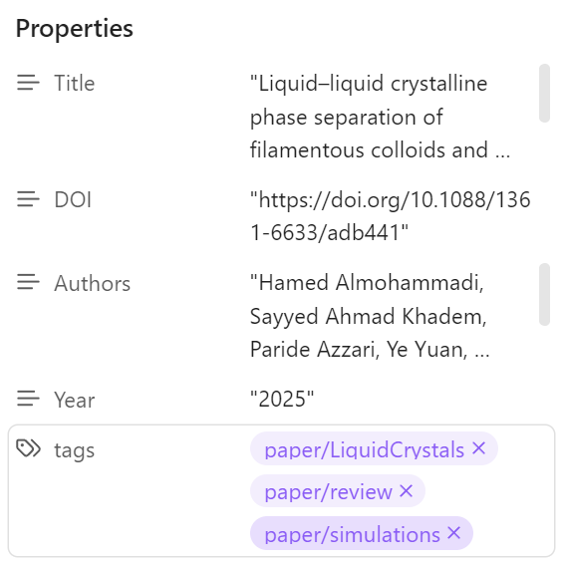
Some Obsidian basics
Obsidian uses Markdown, a lightweight markup language used to format plain text documents, basic markdown syntax: https://www.markdownguide.org/basic-syntax/
Bidirectional linking: Backlinks are automatically created when you link files.
Can embed images, audio, video and PDFs by dragging them into a note, this will save the file to your vault.
Folders are good for storage, not retrieval
Minimize number, use broad folders
Tags add structure and context
Use them to classify notes by function, concept, or relation
Scale well in the long term
Can use nested tags for hierarchy

Slide 17
Guiding Principles for Note Taking with Obsidian
Link excessively, summarize ruthlessly: More links = More insight, there is a tradeoff between note size and creativity
Build on your previous knowledge: Make sure you can connect new notes to existing content, avoid creating independent notes
Notes are a way of meditating on your thinking process: Don’t aim to produce a document, aim to structure your thoughts to improve your own understanding and provide fertile ground for novel ideas
As you read: Focus on highlighting concepts which you can easily connect
Don’t obsess over how: Start and evolve to fit your thinking process
K.I.S.S.: lots of shiny apps and plugins, find what you need and stick to it
Balance existing knowledge with your own thinking: Don’t just copy paste but always have a source to backup your claims

Slide 18
Starter Vault and Demo

